Slide 1
Machine Learning

Slide 2
Definition of machine learning
Machine learning focuses on the development of computer programs that can access data and use it learn for themselves.
The primary aim is to allow the computers learn automatically without human intervention or assistance and adjust actions accordingly.
Machine learning explores the study and construction of algorithms that can learn from and make predictions on data .
Machine learning is a core subarea of artificial intelligence.
In general, machine learning is about learning to do better in the future based on what was experienced in the past.

Slide 3
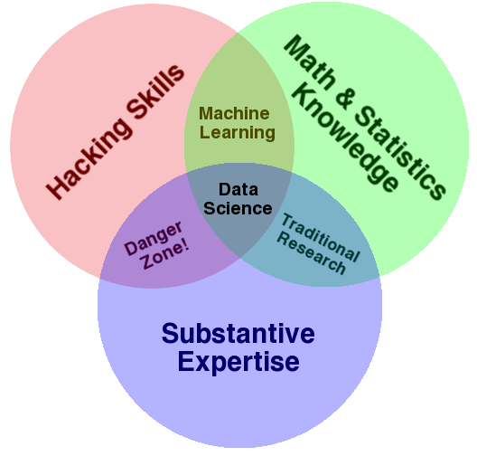
How ML is done

Slide 4
Applications of ML
Speech to text
Natural Language Processing
Conversation/chatbots
Language Translation
Visual recognition
Fighting Web spam
Assistive and Medical Tech
Playing Video Games Automatically
Face Detection

